Slide 1

ECB1204 – ANALOG INTEGRATED CIRCUIT DESIGN IMPLEMENTATION OF AUTOMATIC TEMPERATURE CONTROLLER USING IC 741
Presented by:
AKASH K(2303811710621009)
ESHWARAN K(2303811710621025)
HARI PRASATH M(2303811710621029)
Under the Guidance of
PARTHIPARAJ
ASSISTANT PROFESSOR
ECE

Slide 2
OUTLINE
ABSTRACT –MODULE 1
INTRODUCTION
BLOCK DIAGRAM
HARDWARE REQUIREMENT
ADVANTAGES AND APPLICATIONS
CONCLUSION
PROJECT PLAN
REFERENCES

Slide 3
MODULE 1 -TITLE
AUTOMATIC TEMPERATURE CONTROLLER USING IC 741

Slide 4
ABSTRACT
1. The project focuses on designing an Automatic Temperature Controller using the IC 741 operational amplifier.
2. A thermistor is employed as a temperature sensor, converting temperature variations into voltage changes.
3. The IC 741 acts as a comparator, comparing the thermistor’s output with a user-defined reference voltage. 4. This system is cost-effective, energy-efficient, and ideal for applications requiring precise and automated temperature regulation.

Slide 5
INTRODUCTION
Temperature control is a critical requirement in various domains, including industrial processes, medical equipment, and home automation systems. Traditional manual systems are less efficient and prone to human error, which can lead to undesirable results. An Automatic Temperature Controller eliminates the need for manual intervention by continuously monitoring and adjusting the temperature.
The IC 741 is a versatile operational amplifier that is used as a comparator in this project.the system controls a relay, which switches the heating or cooling element.

Slide 6
ADVANTAGES
Simple Design:
The circuit is easy to design, understand, and implement, even for beginners.
Cost – Effective:
Utilizes low-cost components, making it an affordable solution for temperature control.
Versatile Application:
Suitable for a variety of applications, including industrial equipment, household appliances, and scientific instruments.

Slide 7
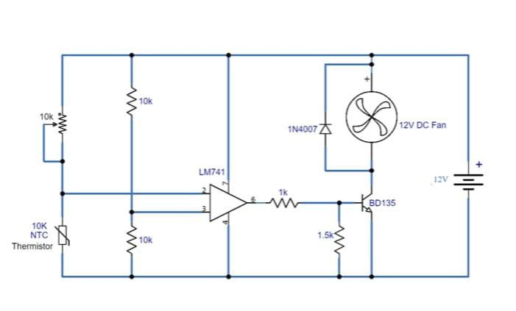
BLOCK DIAGRAM

Slide 8
HARDWARE MODULE
IC 741
NTC Thermistor
Potentiometer
Power Transistor (BD135)
Resistors (10kΩ, 1.5kΩ)
Flyback Diode (1N4007)
DC Fan load (12V)
Power Supply

Slide 9
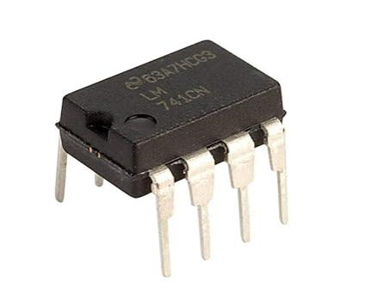
IC 741
The IC 741 operational amplifier is used as a comparator in the circuit. It compares the voltage from the temperature sensor (thermistor) with the reference voltage to determine if the temperature has crossed the set threshold.

Slide 10
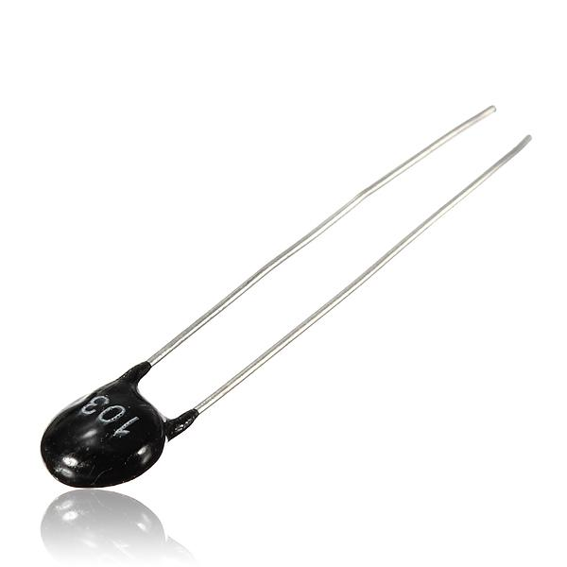
NTC thermistor
A 10kΩ NTC thermistor serves as the temperature sensor. Its resistance decreases as the temperature increases, providing a voltage signal proportional to the surrounding temperature.

Slide 11
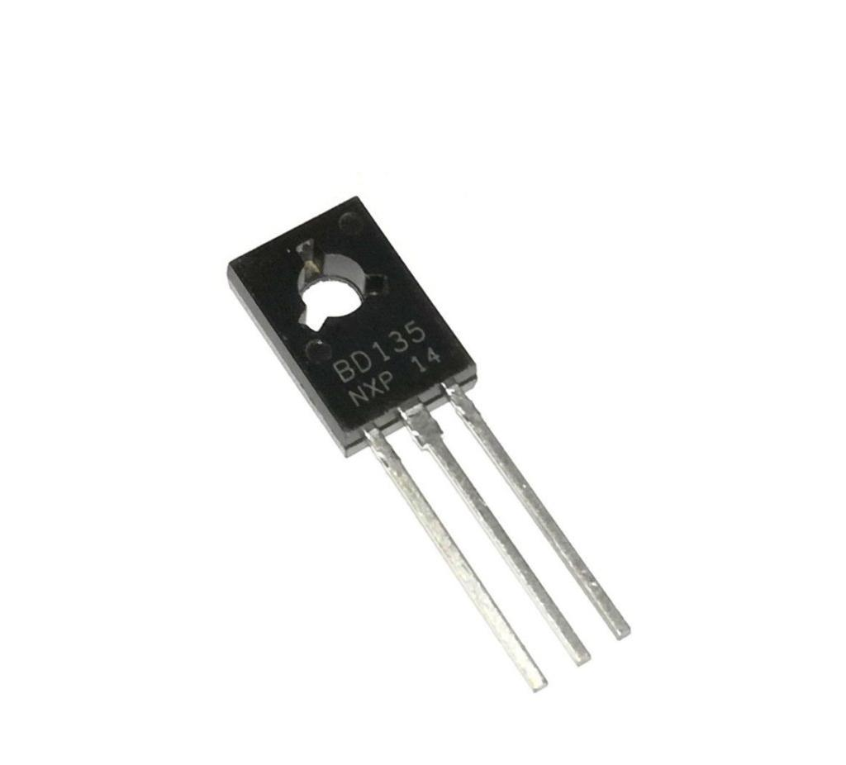
Power Transitor (BD135)
This transistor acts as a switch to control the load (e.g., fan or heater). It enables fast and reliable switching of high-current loads based on the IC 741 output.

Slide 12
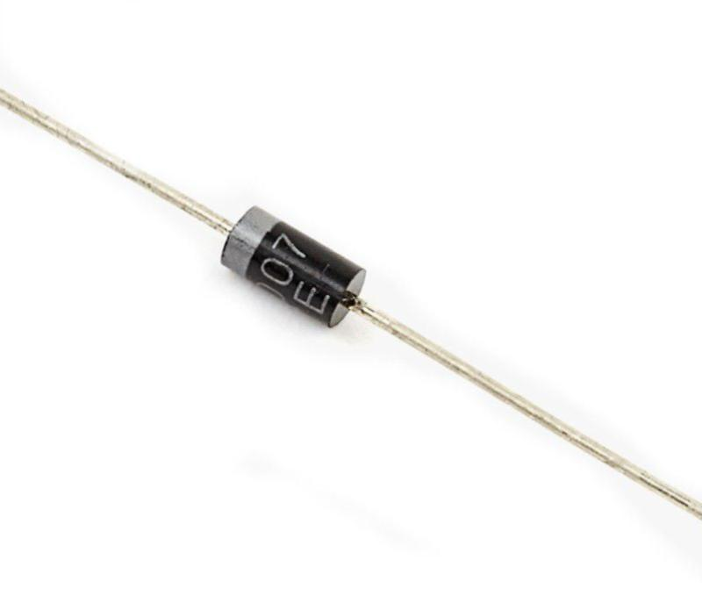
Flyback Diode(1N4007)
A 1N4007 diode is placed across the load to protect the transistor from voltage spikes generated by inductive loads like DC fans.

Slide 13
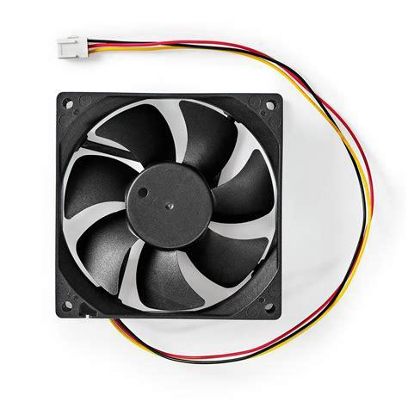
DC Fan Load
A 12V DC fan serves as the cooling device. It operates efficiently.

Slide 14
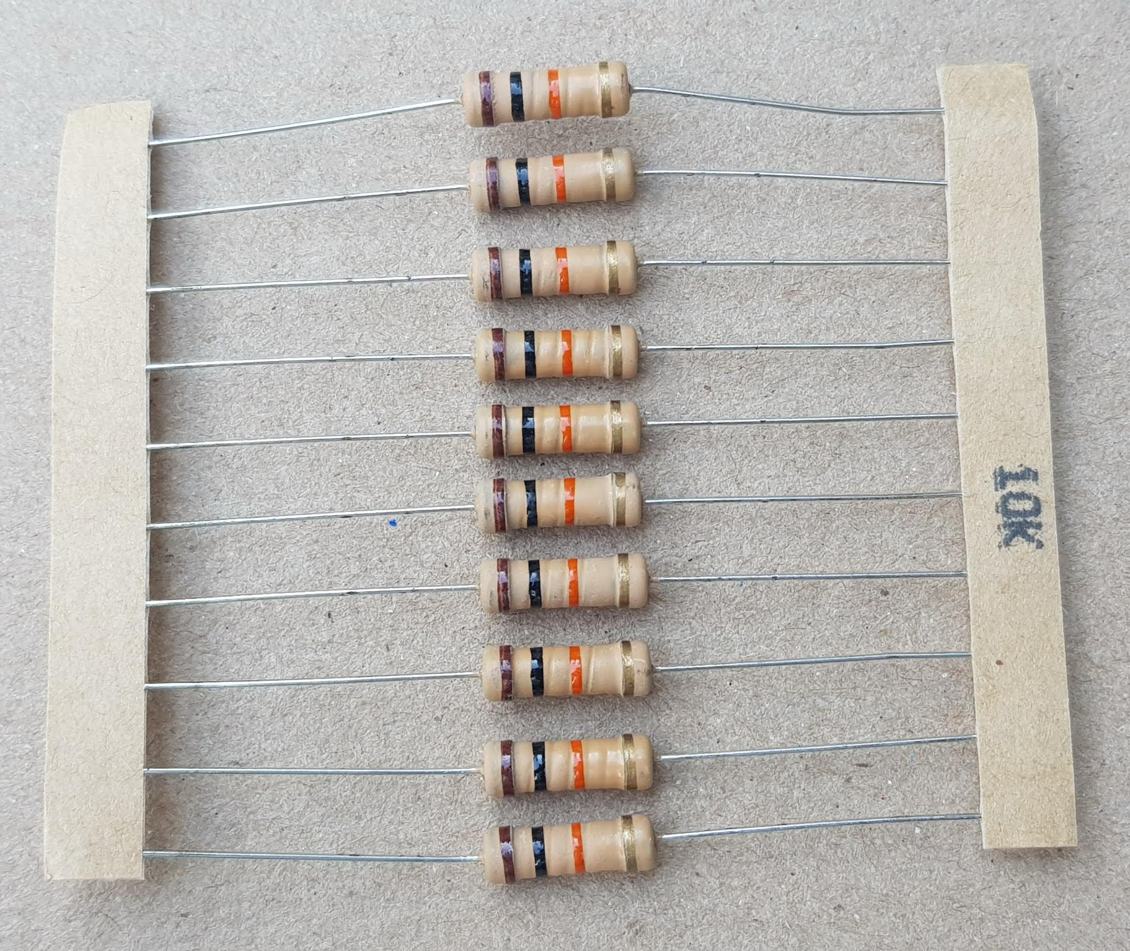
RESISTOR
Fixed 10kΩ resistors are used in the voltage divider circuit with the thermistor and as pull-down resistors where needed.

Slide 15
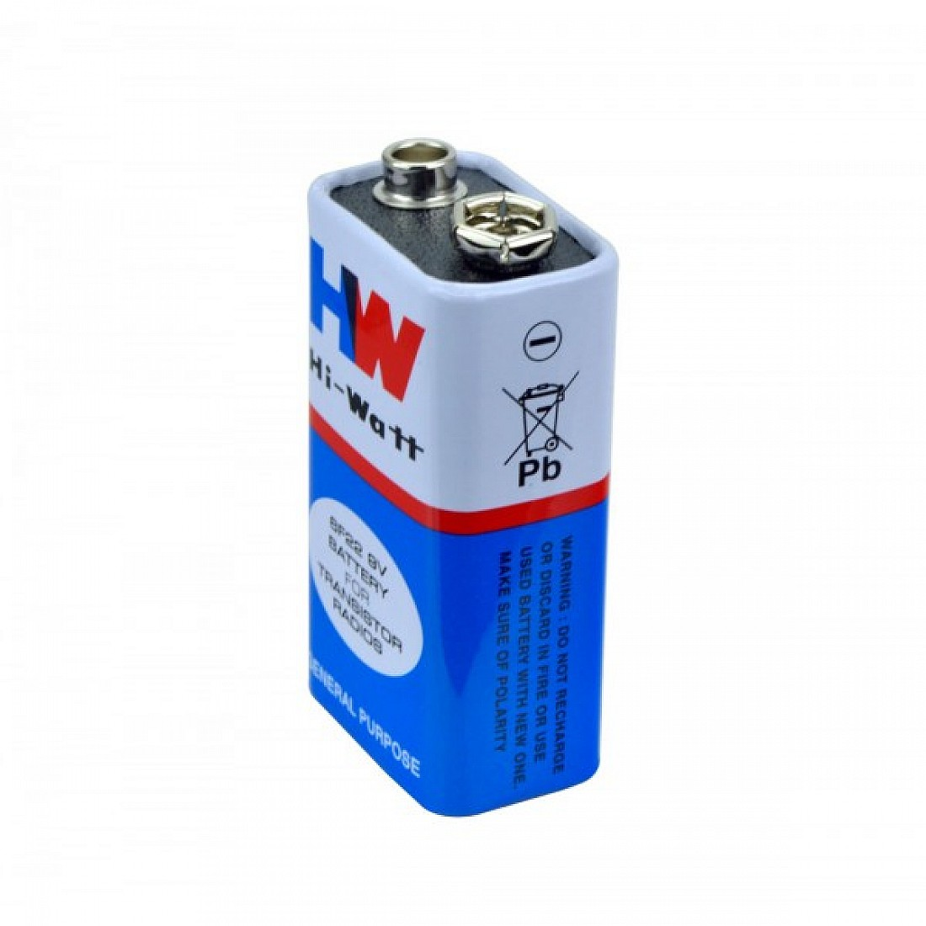
POWER SUPPLY
A regulated power supply is an essential tool in electronics that provides a constant and stable output voltage or current to a circuit or device. Unlike unregulated power supplies, an RPS compensates for input voltage fluctuations and load variations, ensuring that the connected circuit receives a steady and clean power source.

Slide 16
CONCLUSION
The Automatic Temperature Controller using IC 741 is an efficient and simple system for managing temperature automatically. It uses basic components like a thermistor and an op-amp to control heating or cooling devices based on a set temperature. This system is cost-effective, reliable, and useful in many applications.

Slide 17
PROJECT PLAN
Project Objective: Design and implement a temperature controller using IC 741 to automate heating or cooling devices.
Circuit Setup: Research and understand the components.Design the circuit diagram. Assemble the circuit on a breadboard.Test and calibrate the circuit for desired temperature.
Testing and Finalization: A working automatic temperature controller and give a brief report.

Slide 18
REFERENCES
“Op-Amps and Linear Integrated Circuits” by Ramakant A. Gayakwad (Concepts on IC 741).
“Electronic Devices and Circuits” by Boylestad and Nashelsky (Comparator circuits).
IC 741 Operational Amplifier Datasheet for pin configuration and specifications.

Slide 19
THANK YOU

